Slide 1


Giving a Research Talk
--- Structure and Delivery
Da Gong
dgong005@ucr.edu
PhD Candidate, Economics
GradQuant
@MacREU
July 06 2023

Slide 2
Thanks to
Jason Chou
Zhuocheng Shang

Slide 3
Outline
Part I: Structure and Organization
Title Page
Examples (Optional)
Outline Slide
Introduction
Experiment and Methods
Results and Discussion
Conclusions
Questions
Thanks
Reference
Appendix
Part II: Delivery and Confidence
Preparing your content for delivery
Preparing for your audience
Software

Slide 4
Part I: Structure and Organization
Title Page
Examples (Optional)
Outline Slide
Introduction
Experiment and Methods
Results and Discussion
Conclusions
Questions
Thanks
Reference
Appendix

Slide 5
Title Page
Research Title
Author(s)
Email
School

Slide 6

Title Page --- e.g.

Slide 7
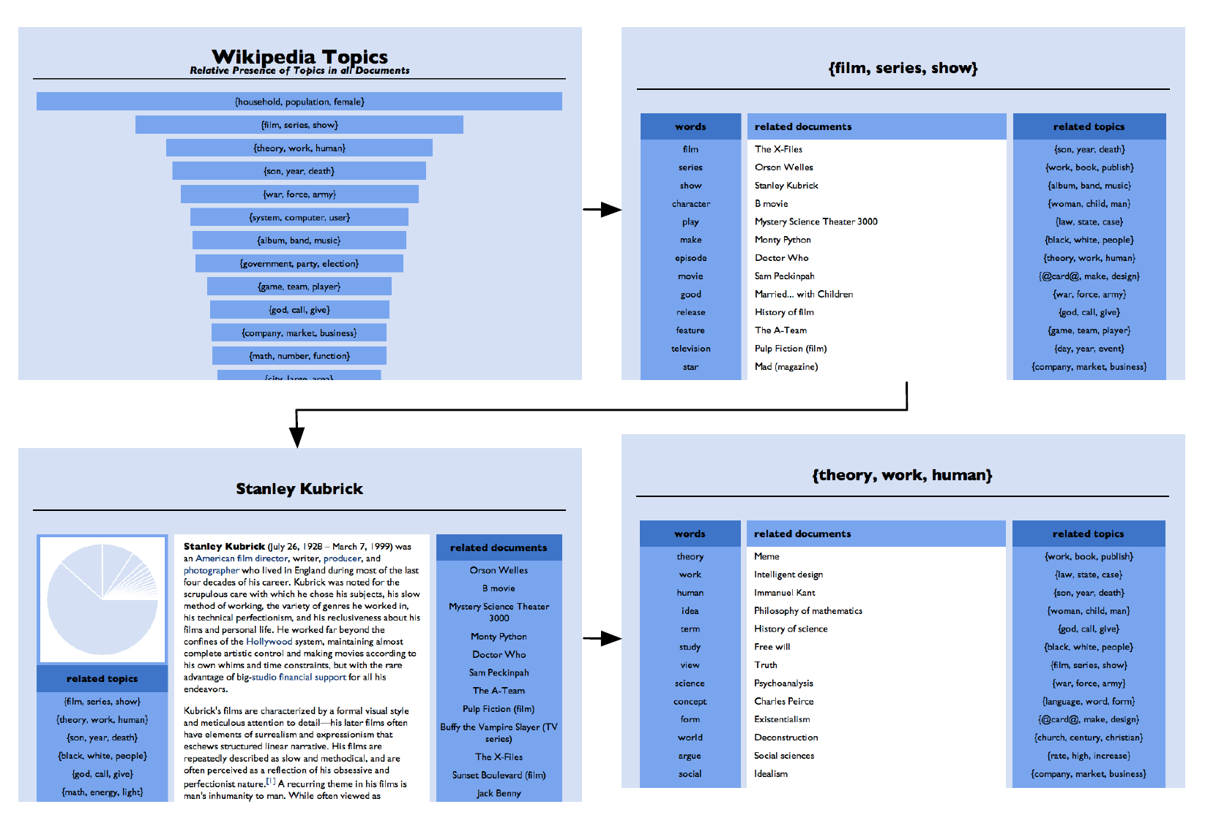
Examples (Optional)
Include 1 or 2 examples of the problem you are solving
Ref:
Probabilistic Topic Models: Origins and Challenges, David M. Blei, 2013

Slide 8
Outline Slide
Introduction
Experiment and Methods
Results and Discussion
Conclusions
Questions
Thanks
Reference
Appendix

Slide 9
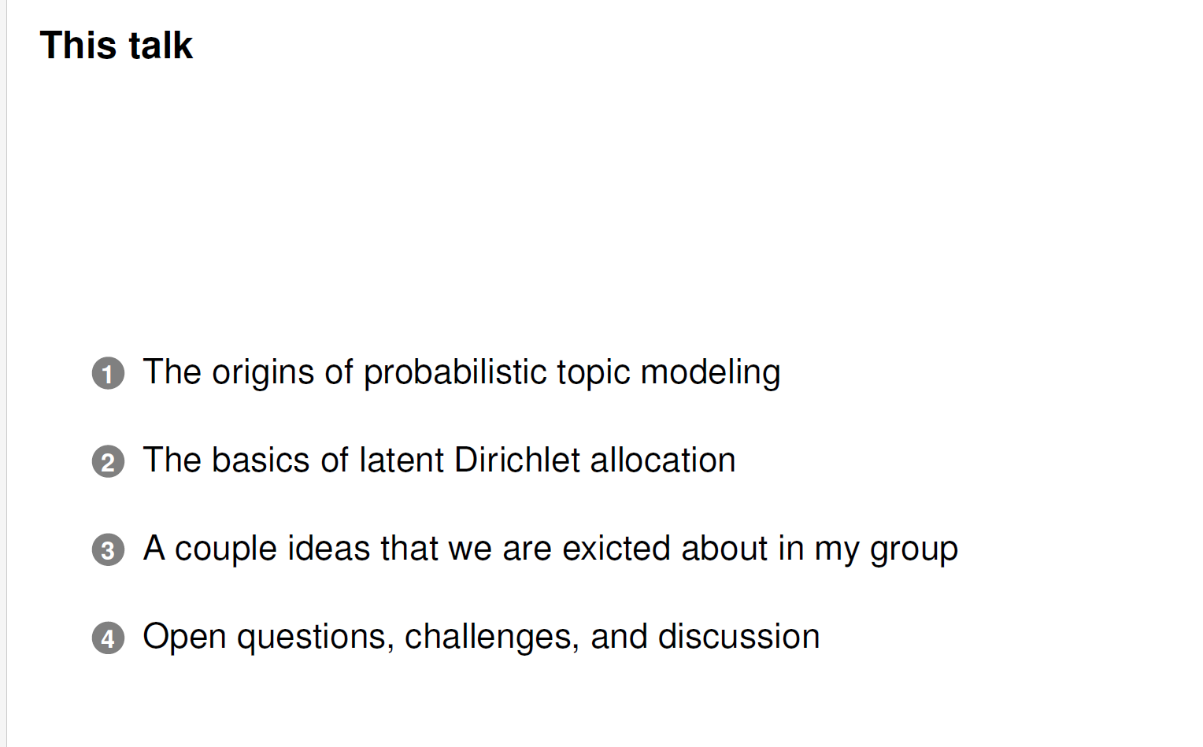
Outline Slide --- e.g.
Ref:
Probabilistic Topic Models: Origins and Challenges, David M. Blei, 2013

Slide 10
Introduction
Research Question
Background
Previous Research
Methods and Finding (Optional and Brief)
Contribution
Watchout!
Sessions might overlap with each other,
you don’t want to include all of these above

Slide 11
Introduction --- cont.
“The Introduction define the context for the current work reported. How does this paper relate to what has been done previously? In the process it should point readers to publications to which they may need to refer in order to understand the motives for the current research.” (Thrower, 2008)
Bad example: ‘‘Carbon is the most versatile element on the earth. Two forms, diamond and graphite, were discovered in the 18th century. There then followed 200 years with no major advances until the discovery of fullerenes in 1985, for which Nobel prizes were awarded. Etc.’’
Ref:Peter A. Thrower, Writing a scientific paper: II. Introduction and references, Carbon, Volume 46, Issue 2, 2008

Slide 12
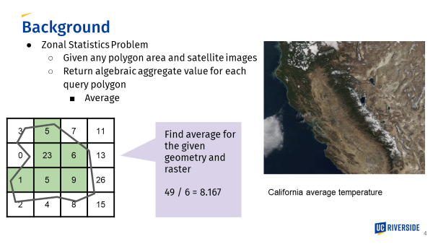
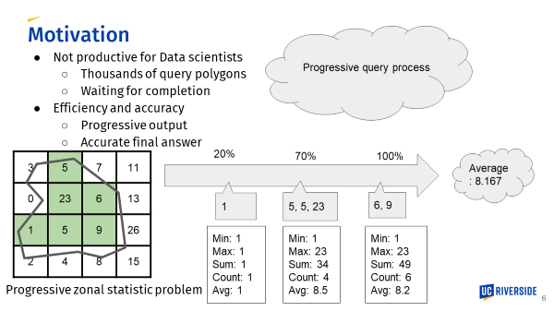
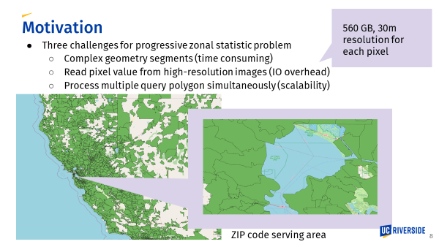
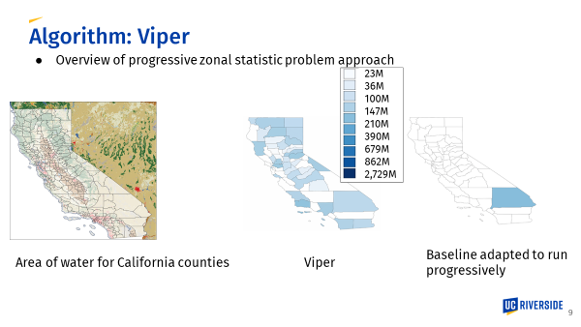
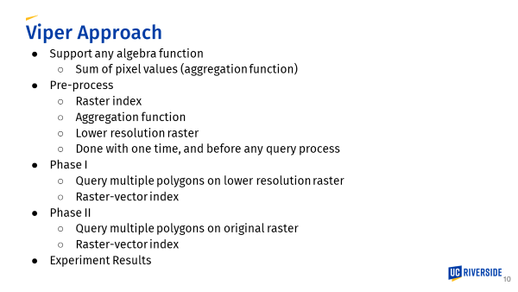
Introduction --- e.g. 1
Ref:
Zhoucheng Shang 2023

Slide 13
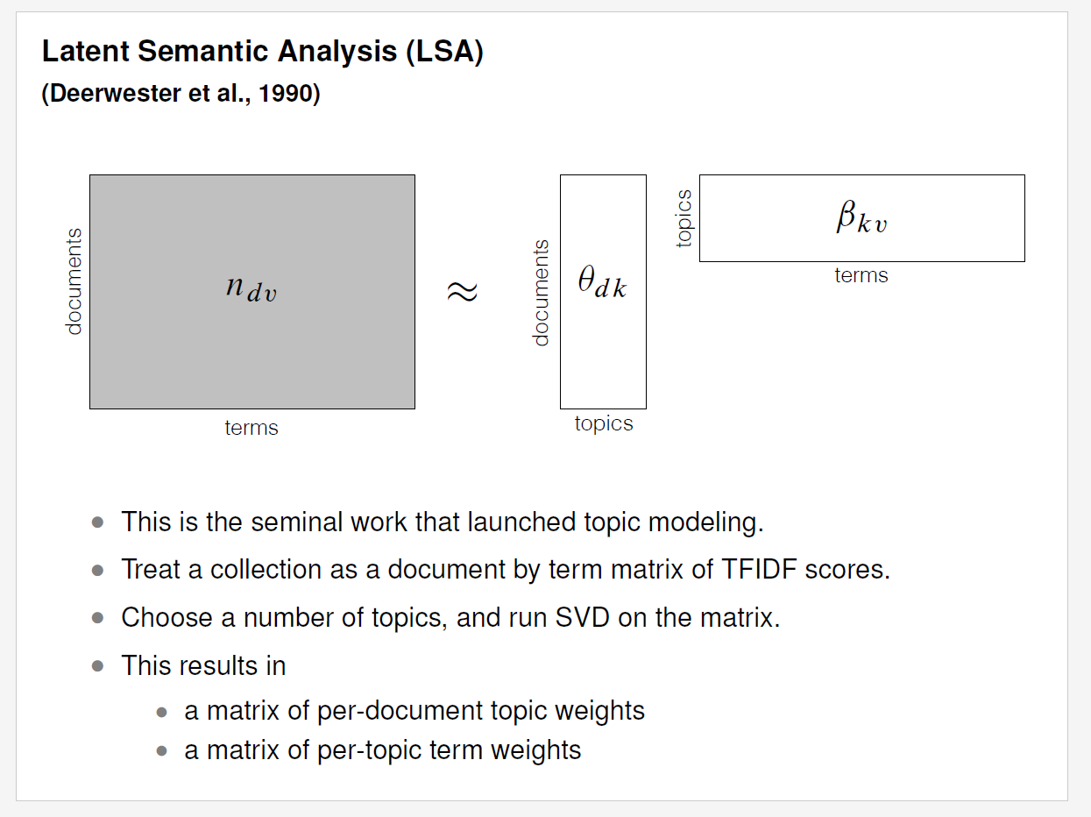
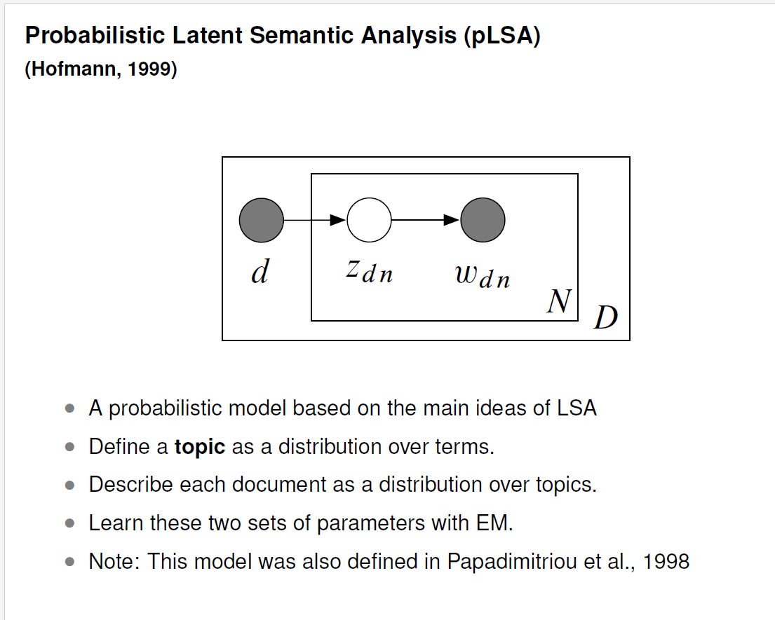
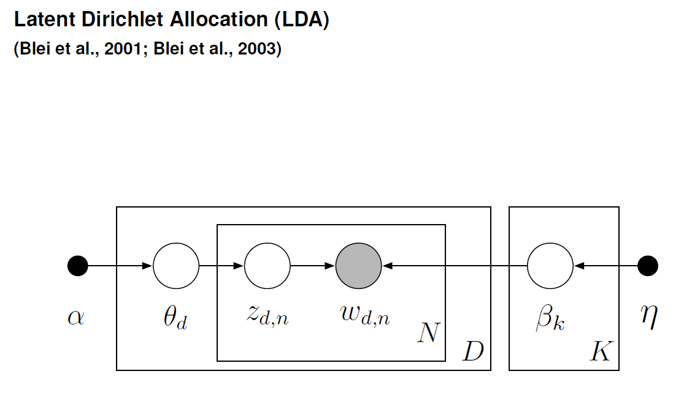
Introduction --- e.g. 2
Ref:
Probabilistic Topic Models: Origins and Challenges, David M. Blei, 2013

Slide 14
Experiment and Methods
Sample Preparation
Characterization (Setting)
Equipment (maybe?)
……

Slide 15
Experiment and Methods --- Cont.
Make Sure:
Replicable
Experiments are well designed
Major points

Slide 16
Results and Discussion
Present data clearly (table & figure)
Don’t overinterpret
Ref: Peter A. Thrower, Writing a scientific paper: IV. Results and discussion,
Carbon, Volume 48, Issue 10, 2010, Pages 2675-2676

Slide 17
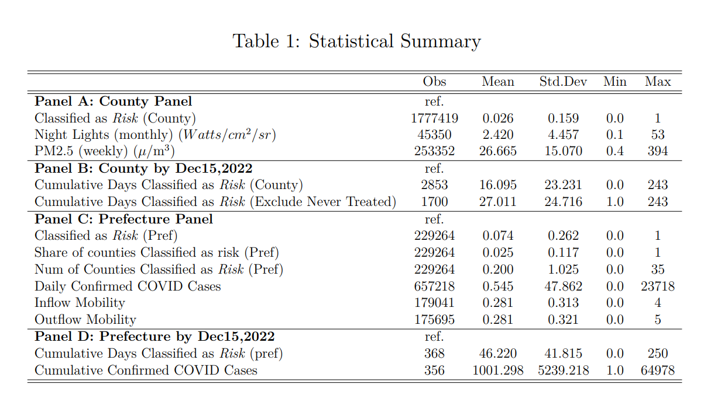
Results and Discussion --- e.g.

Slide 18
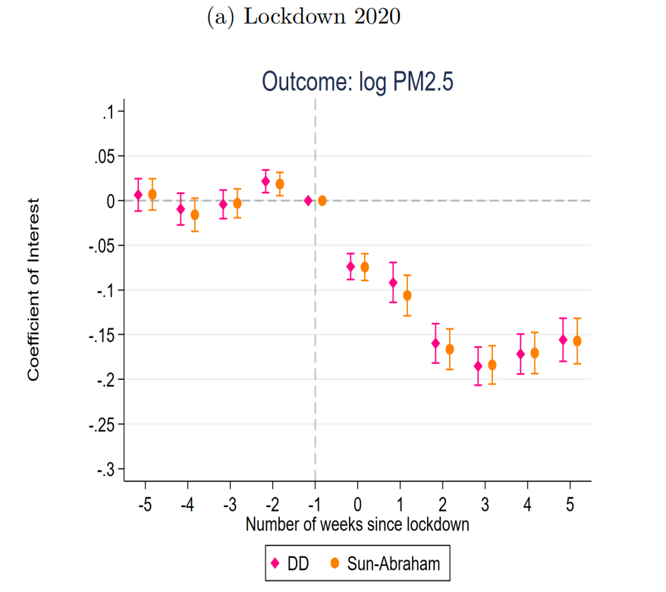
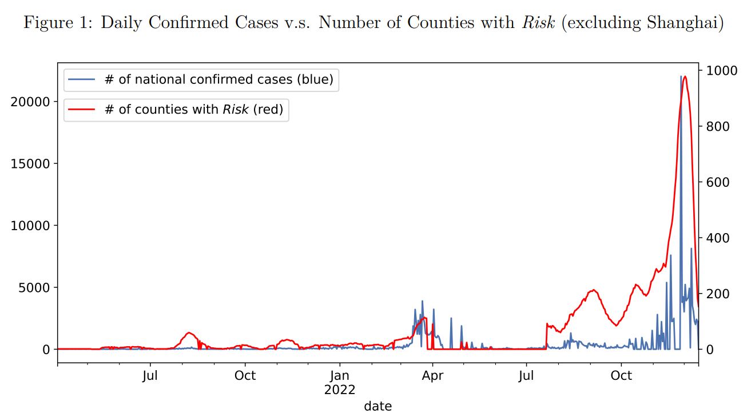
Results and Discussion --- e.g. Cont.
Ref: Gong. et al, 2023

Slide 19
Conclusion
Methods (brief)
Contributions
Wrap up findings
Limitations and Future Directions

Slide 20
Questions?

Slide 21
Thanks!
Da Gong
Economics, UC Riverside
dgong005@ucr.edu

Slide 22
Reference
David M. Blei. 2012. Probabilistic topic models. Commun. ACM 55, 4 (April 2012), 77–84.
https://doi.org/10.1145/2133806.2133826
Zhoucheng Shang, Viper: Interactive Exploration of Large Satellite Data, working paper, 2023
Gong, Da and Shang, Zhuocheng and Su, Yaqin and Yan, Andong and Zhang, Qi,
A Systematic Evaluation of the Economic Impacts of China’s Zero-COVID Policies (April 17, 2023).
Peter A. Thrower, Writing a scientific paper: II. Introduction and references, Carbon, Volume 46, Issue 2, 2008
Peter A. Thrower, Writing a scientific paper: IV. Results and discussion, Carbon, Volume 48, Issue 10, 2010, Pages 2675-2676
Useful links:
https://brand.ucr.edu/document/ucr-powerpoint-templates-2020
http://www.ifs.tuwien.ac.at/~silvia/research-tips/
https://www.ics.uci.edu/~goodrich/presenting.html
https://www.cs.swarthmore.edu/~newhall/presentation.html
https://homes.cs.washington.edu/~mernst/advice/giving-talk.html#introduction
https://www.materialstoday.com/how-to-craft-a-materials-sicence-research-paper/

Slide 23
Appendix
Results cannot put into main slides (table, graph, interpretation…)
(maybe) equipment list
Extra experiment details …
Hyperlink between main slides and Appendix

Slide 24
Part II: Delivery and Confidence
Preparing your content for delivery
Preparing for your audience
Software

Slide 25
Preparing Your Content for Delivery
Organize your talk (paper)
Identify important points
Create a talk outline /structure
Designing your slides
Organize slides into an outline
Print it out and write down notes

Slide 26
Preparing Your Content for Delivery --- Cont.
Style
Not cluttered with information (okay to have empty space)
Font size, color, background ….
1 slide for every 1-3 minutes
A figure is worth a thousand words (e.g. figure, video, Interactive 3D Plots)
Not too fancy (maybe)
No duplicated Slide titles
Provide a “talk roadmap”

Slide 27
Talk Roadmap --- e.g.
Title Page
Outline slide
Introduction
Experiment and Methods
Results and Discussion
Conclusions
Questions
Thanks
Reference
Appendix

Slide 28
Talk Roadmap --- e.g. Cont.
Title Page
Outline slide
Introduction
Experiment and Methods
Results and Discussion
Conclusions
Questions
Thanks
Reference
Appendix

Slide 29
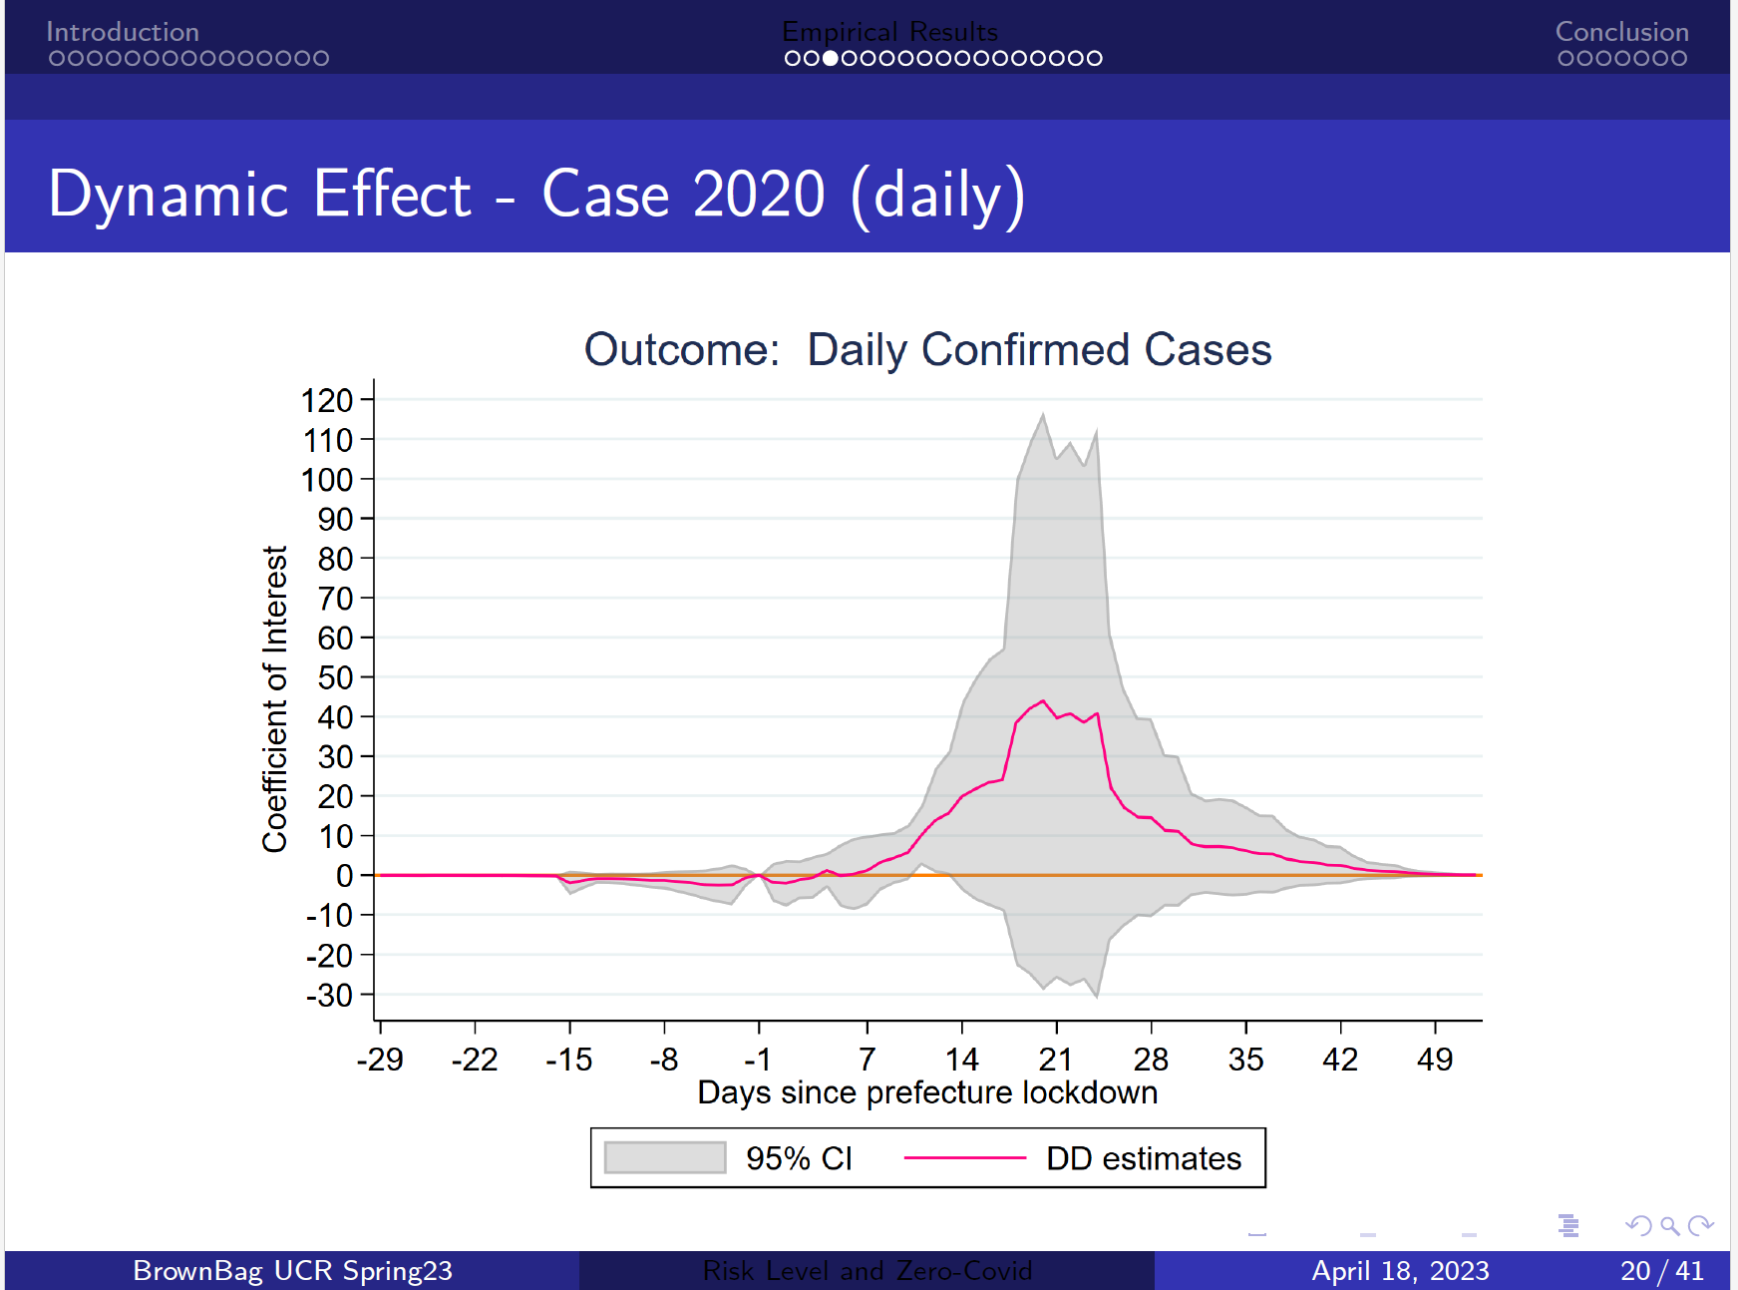



Talk Roadmap --- e.g. 2

Slide 30
Preparing for your audience
Repeat your main points (contributions)
Talk to the audience

Slide 31
Preparing for your audience --- Cont.
Practice in front of others
Get feedback
Adjust
Practice by yourself
Notes on print copy
Terminology (e.g. filial piety; CdS QDs/g-C3N4)
Practice by doing! (e.g. bronwbag; conference…)
Being nervous is normal (Practice will help)
Time control (Super Important! )
Dress Code

Slide 32
Software
PPT
Latex (Beamer)
Overleaf
…
Markdown (python, R…)

Slide 33
Questions?

Slide 34
Thanks!
Da Gong
Economics and GradQuant
UC Riverside
dgong005@ucr.edu

